Slide 1
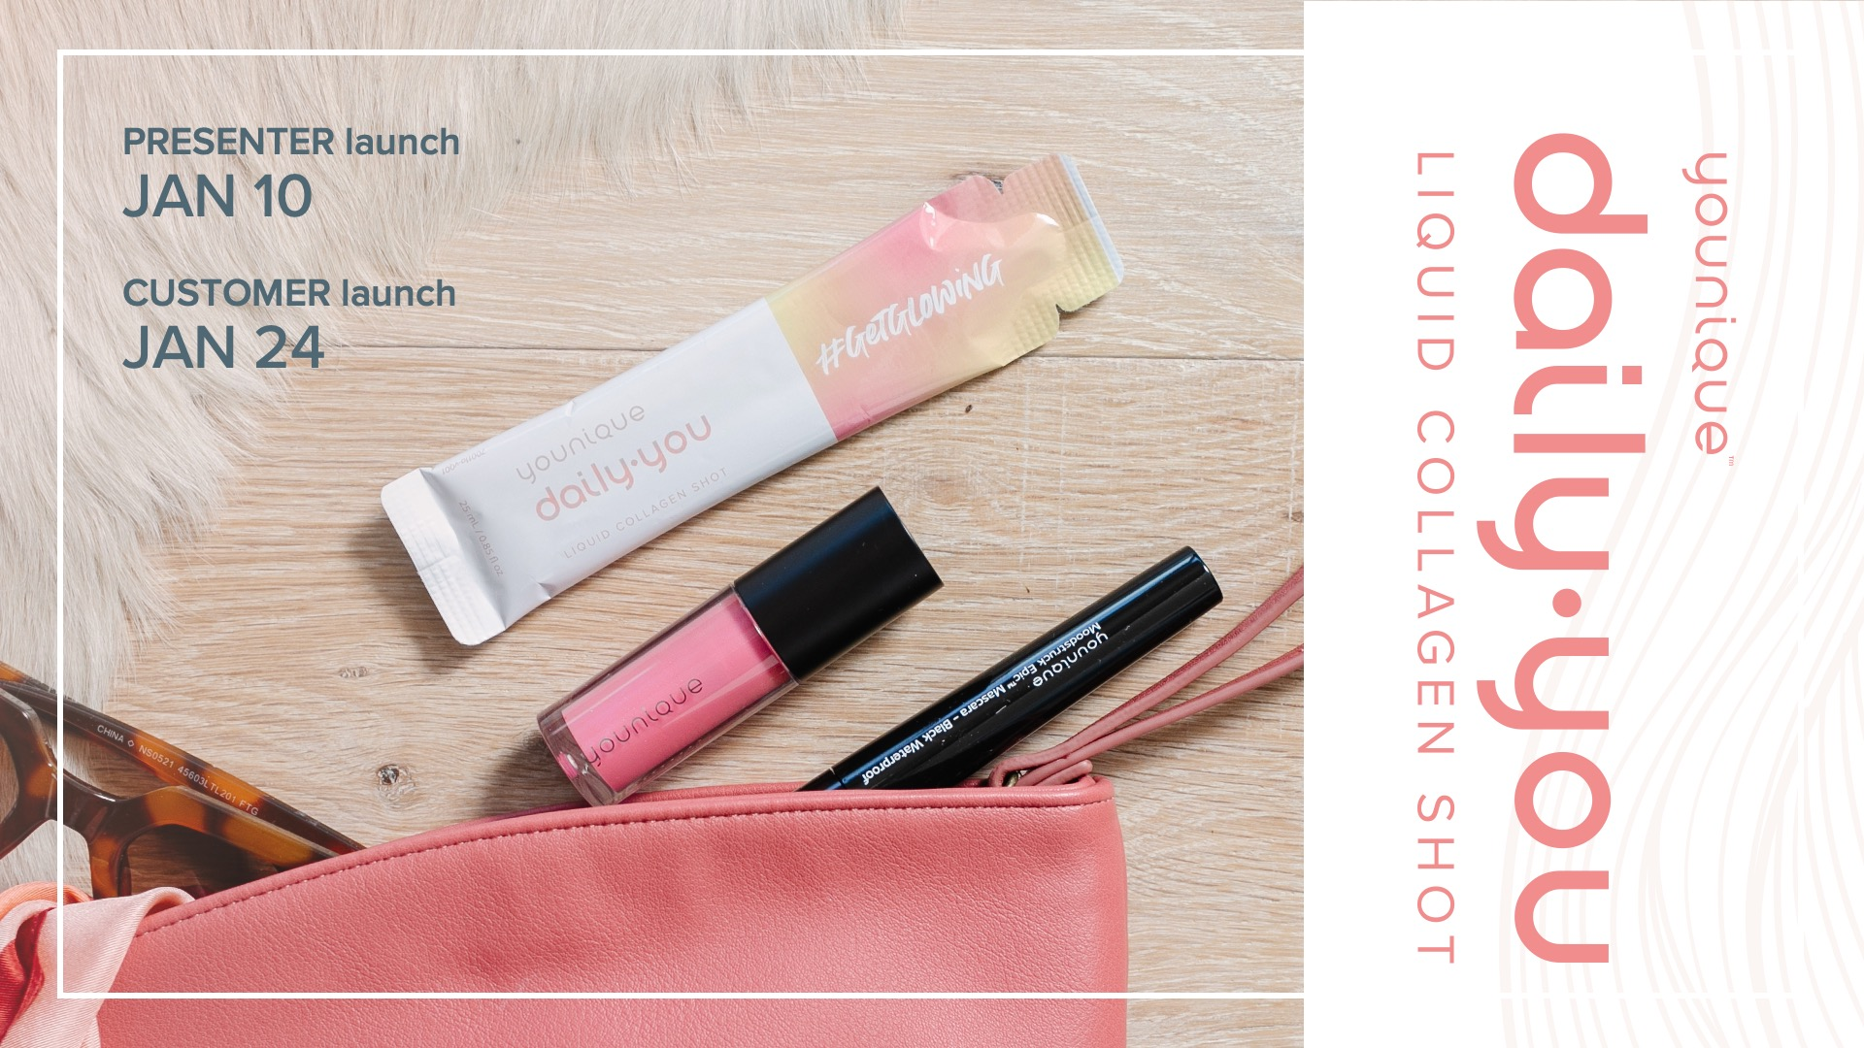
Notes:
YOUNIQUE DAILY⋅YOU liquid collagen shot: Get to know the product that will grow your business
Use these talking points to teach your audience all about the new YOUNIQUE DAILY⋅YOU liquid collagen shot. This product will be a game changer for your business—it’s important to be ready!
Remind your attendees that YOUNIQUE DAILY⋅YOU liquid collagen is available for all Presenters to purchase on January 10 and customers can start purchasing theirs on January 24.

Slide 2
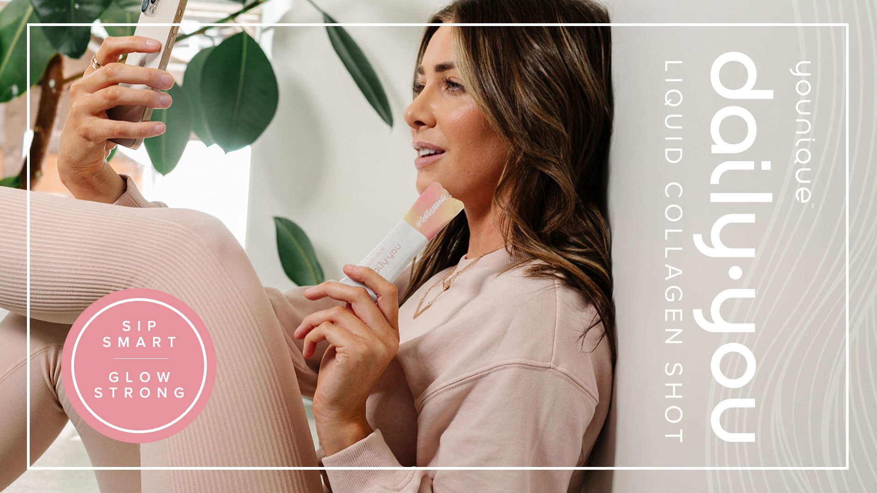
Notes:
YOUNIQUE DAILY⋅YOU liquid collagen shot
SIP SMART. GLOW STRONG.
YOUNIQUE DAILY·YOU liquid collagen shot is on its way and it’s about to revolutionize our product offering, meaning you’ll have new opportunities for your business to grow!
Let’s kick things off by getting to know a little more about what collagen is and why it’s important.

Slide 3

Notes:
What is collagen and why do you need it?
Collagen is a protein responsible for healthy joints and skin elasticity and stretchiness. It's in your bones, muscles, and blood. As you age, your existing collagen breaks down, and it gets harder for your body to produce more. To truly care for your skin, you need to start below the surface. That’s where the YOUNIQUE DAILY⋅YOU liquid collagen shot comes in!
YOUNIQUE DAILY⋅YOU liquid collagen shot nourishes your skin from the inside out. Collagen is generally considered to be a safe daily supplement for healthy individuals, and ours is scientifically formulated with powerful marine collagen peptides and nutrilicious ingredients that work together to magnify the magnificence of you—inside and out.

Slide 4
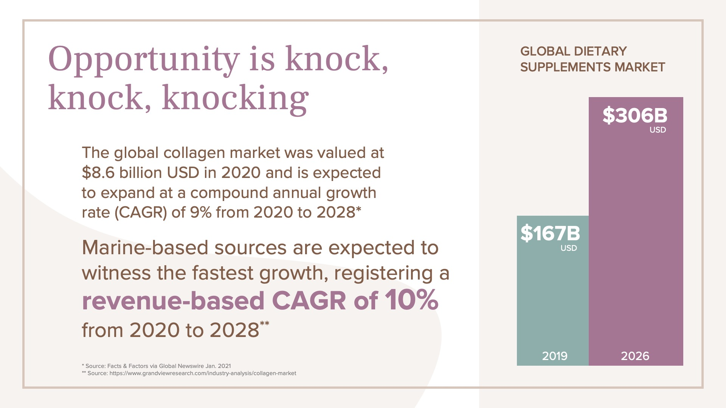
Notes:
Opportunity is knock, knock, knocking
This is an opportunity to grow your business like you’ve never had before. The demand for wellness and beauty products in the anti-aging category is dramatically increasing.
In 2019, the Global Dietary Supplements Market was worth $167 billion USD and it’s expected to grow to $306 billion USD by 2026.* The global collagen market was valued at $8.6 billion USD in 2020 and is expected to expand at a compound annual growth rate (CAGR) of 9% from 2020 to 2028.** Marine-based sources are expected to witness the fastest growth, registering a revenue-based CAGR of 10% from 2020 to 2028.**
* Source: Facts & Factors via Global Newswire Jan. 2021
** Source: https://www.grandviewresearch.com/industry-analysis/collagen-market

Slide 5
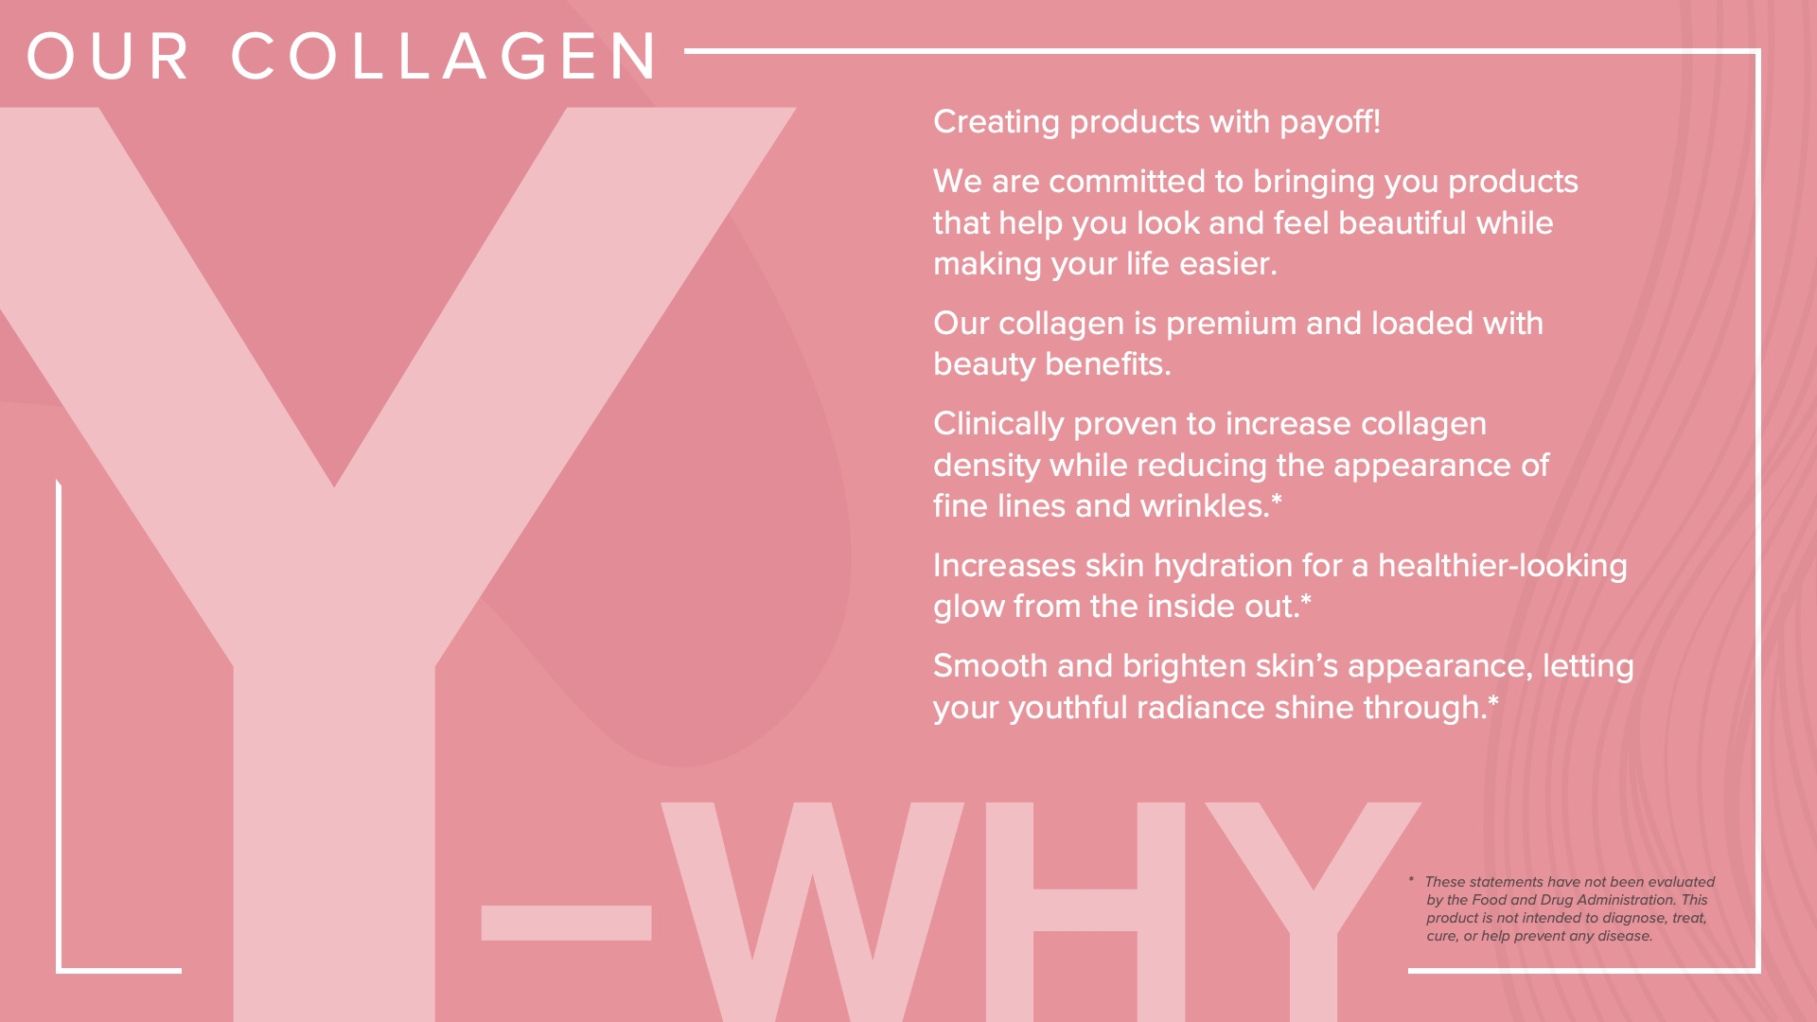
Notes:
Our Collagen Y-Why
Because of the amazing benefits and opportunities collagen provides you, your customers, and your businesses, we knew that we needed to add it to the Younique product offering.
Why collagen?
As a company, we are committed to creating products with payoff. As a beauty industry leader, we are committed to bringing you products that help you look and feel beautiful while making your life easier. Collagen hits all the marks.
Our collagen is premium and loaded with beauty benefits.
This daily drink of gorgeousness has been clinically proven to increase collagen density while reducing the appearance of fine lines and wrinkles.*
Our collagen helps to increase skin hydration for a healthier-looking glow from the inside out.*
YOUNIQUE DAILY·YOU liquid collagen shot helps smooth and brighten skin’s appearance, letting your youthful radiance shine through.*
* These statements have not been evaluated by the Food and Drug Administration. This product is not intended to diagnose, treat, cure, or prevent any disease.

Slide 6

Notes:
Say hello to your new beauty glow-to: YOUNIQUE DAILY⋅YOU liquid collagen shot
YOUNIQUE DAILY⋅YOU liquid collagen shot nourishes your skin from the inside out. It is scientifically formulated with powerful marine collagen peptides and nutrilicious ingredients that work together to magnify the magnificence of you.
If you or someone on your team earned early access to the YOUNIQUE DAILY·YOU liquid collagen shot, take some time to share those experiences and talk about what they love about the product so far.

Slide 7

Notes:
Inner strength is the foundation for a beautiful, confident you—especially when it comes to your skin.

Slide 8

Notes:
Why marine collagen?
It’s powered by nature.
Type I marine collagen is a powerhouse. It’s closer to your natural collagen than bovine and vegan collagens, so your body will already know how to put it to work.
To top it off, our collagen is clean, bioactive, and sustainably/responsibly sourced from around the world. There are no hormones or antibiotics, and it’s better for our planet.
Only the best for you and Mother Earth, we say.

Slide 9
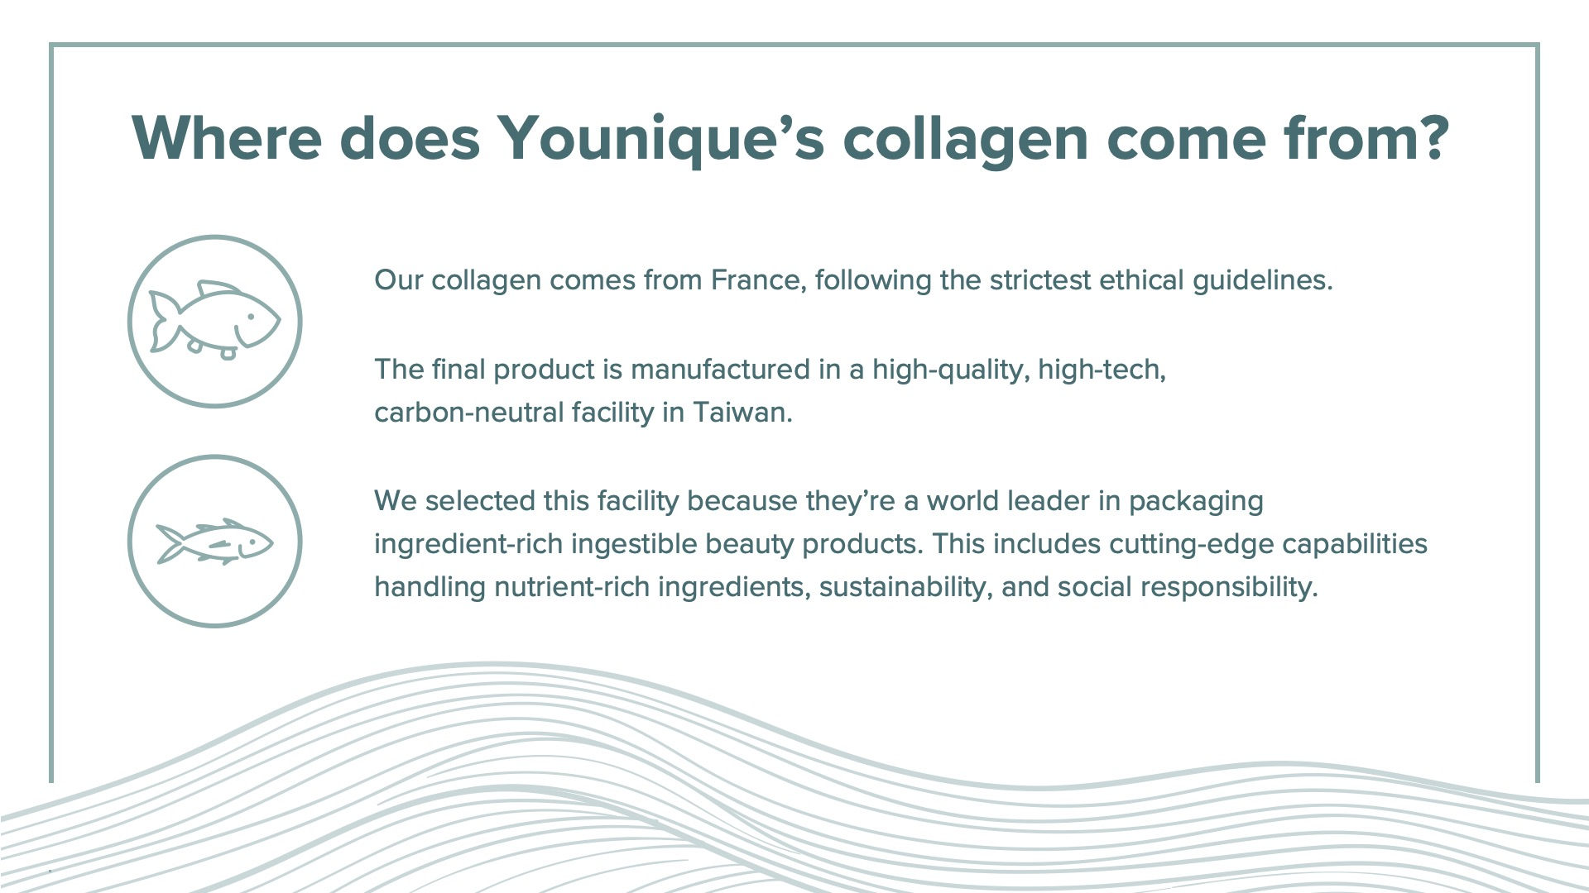
Notes:
Where does Younique’s collagen come from?
Our collagen is farmed in France following the strictest ethical guidelines.
The final product is manufactured in a high-quality facility in Taiwan that specializes in ingestible products.
We took great care to select a manufacturer that is clean and has meticulous attention to detail to ensure the product you receive is high quality every time.

Slide 10
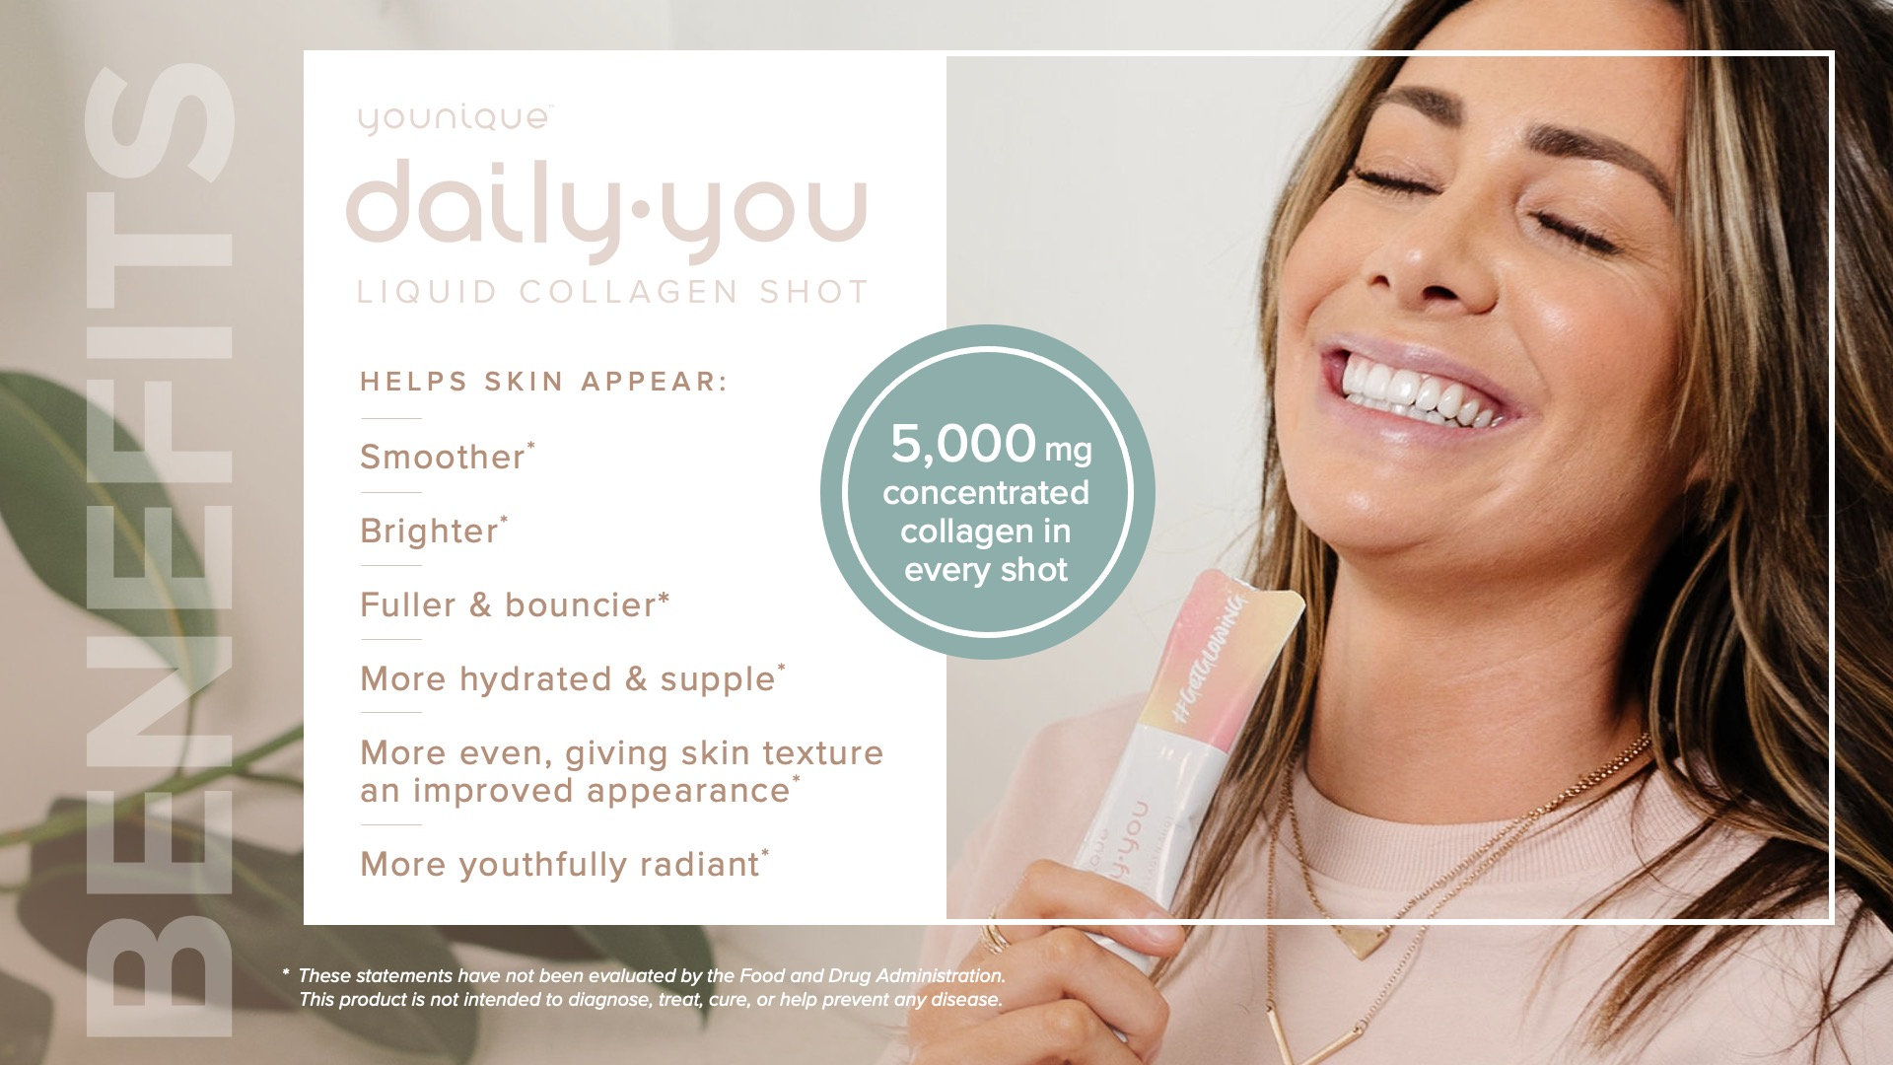
Notes:
Benefits
#Glowstrong
YOUNIQUE DAILY⋅YOU liquid collagen shot helps skin appear:
Smoother*
Brighter*
Fuller & bouncier*
More hydrated and supple*
More even, giving skin texture an improved appearance*
More youthfully radiant*
Micro-absorption technology makes it easier for your body to absorb the collagen
5,000 milligrams of concentrated collagen in every shot

Slide 11
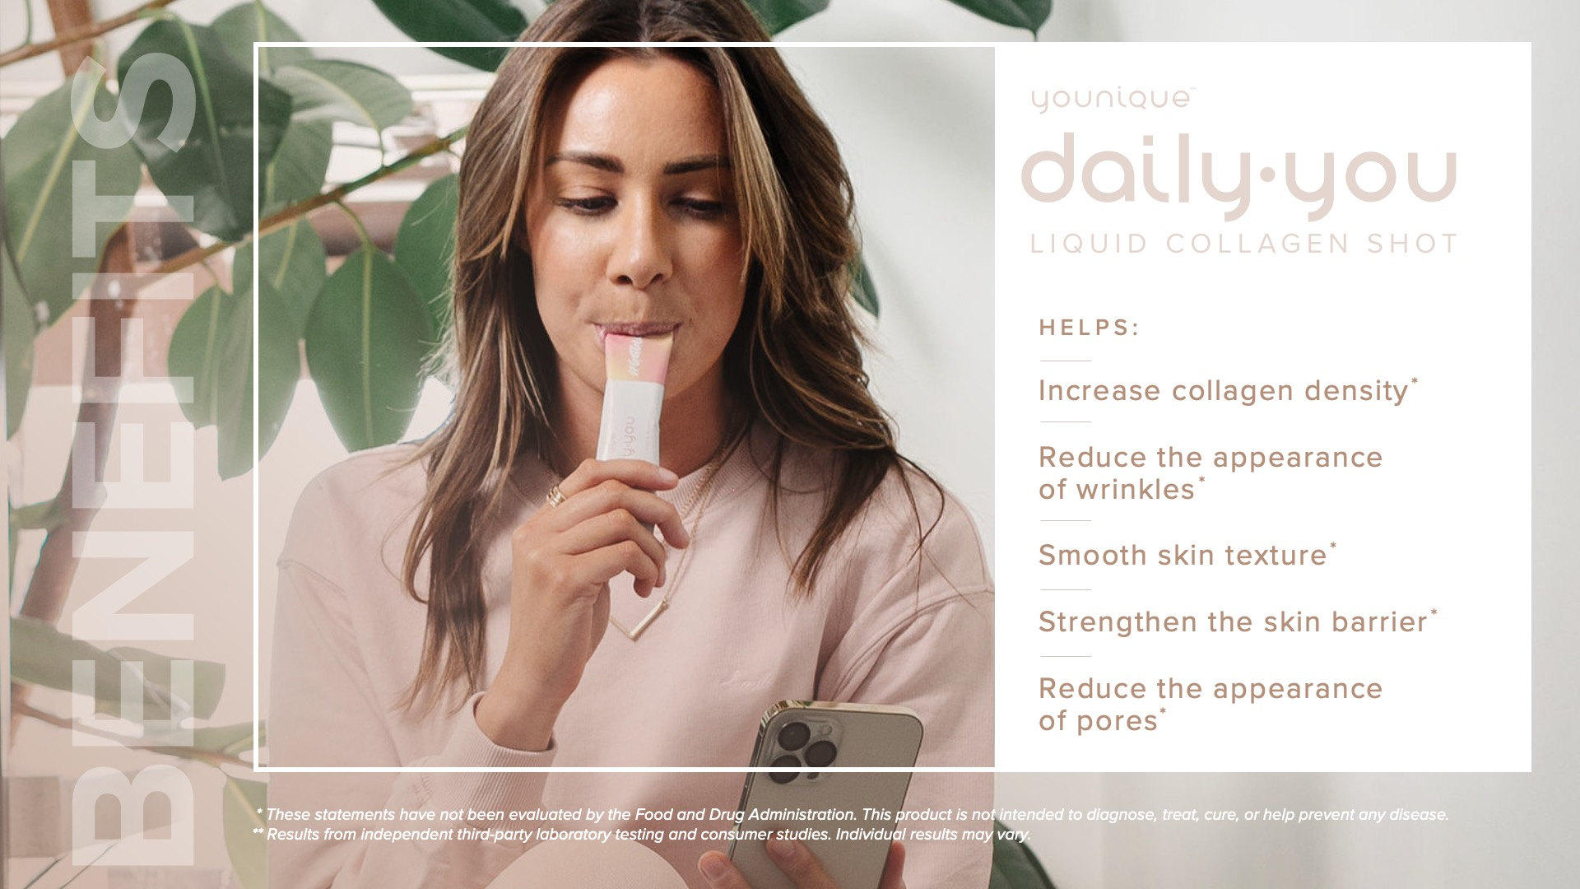
Notes:
In an independent clinical study, YOUNIQUE DAILY⋅YOU liquid collagen shot was found to help:
Increase collagen density​*
Reduce the appearance of wrinkles​*
Smooth skin texture​*
Strengthen the skin barrier​*
Reduce the appearance of pores*
* These statements have not been evaluated by the Food and Drug Administration. This product is not intended to diagnose, treat, cure, or prevent any disease.

Slide 12
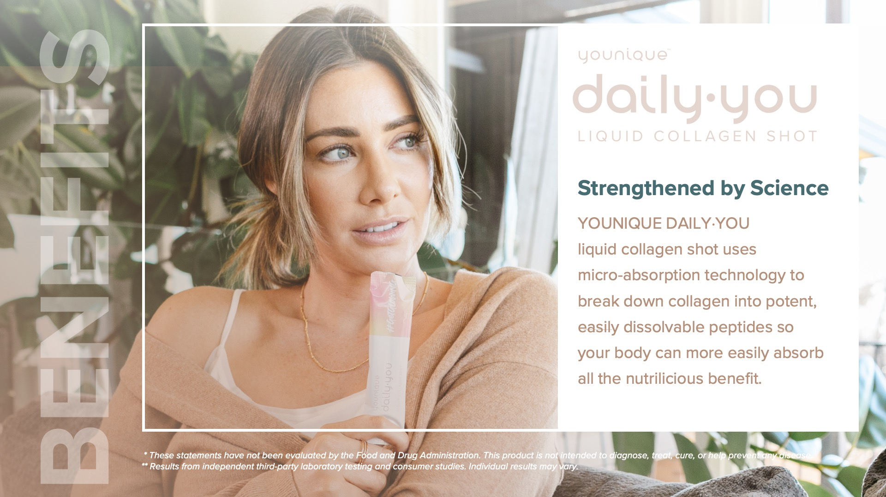
Notes:
In an independent clinical study, YOUNIQUE DAILY⋅YOU liquid collagen shot was found to help:
Increase collagen density​*
Reduce the appearance of wrinkles​*
Smooth skin texture​*
Strengthen the skin barrier​*
Reduce the appearance of pores*
* These statements have not been evaluated by the Food and Drug Administration. This product is not intended to diagnose, treat, cure, or prevent any disease.

Slide 13
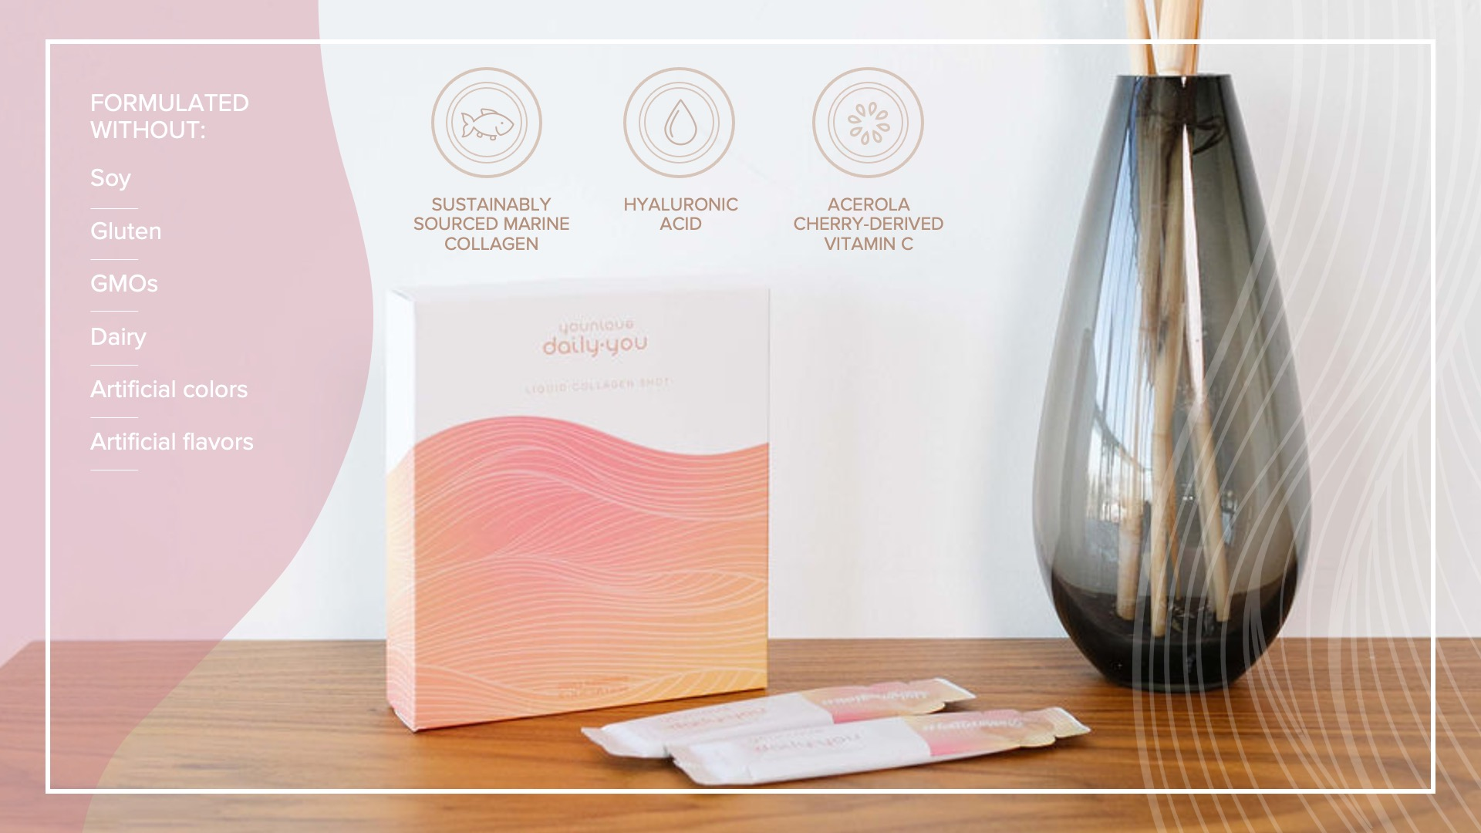
Notes:
Key ingredients
Sustainably Sourced Marine Collagen
Marine collagen is closer to your body’s natural collagen than bovine or vegan collagen. Your body already knows how to put it to work.
Sustainably sourced and bioactive to help protect our planet—only the best for you and Mother Earth!
Hyaluronic Acid
Made naturally by our bodies, hyaluronic acid acts like a sponge to help maintain moisture for skin that looks plumper, softer, and more supple.
Acerola Cherry-Derived Vitamin C
An antioxidant that helps give skin a brighter, more glowing appearance.
Formulated without:
Soy
Gluten
GMOs
Dairy
Artificial colors
Artificial flavors
#sustainablysourced #responsiblysourcecd #marinecollagen

Slide 14
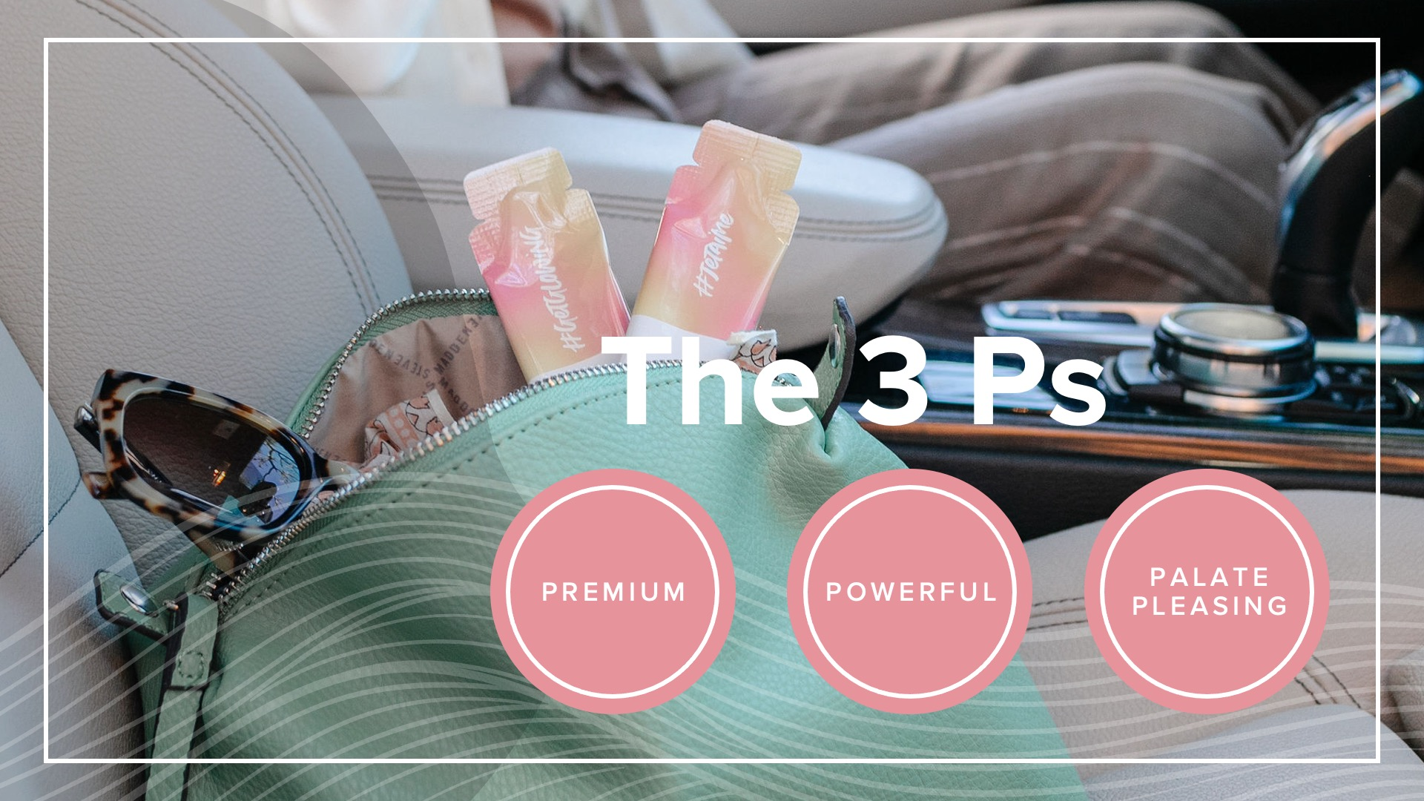
Notes:
The 3 Ps
PREMIUM
Sustainably sourced marine collagen that your body can easily absorb for a collagen boost.
POWERFUL
More power to YOU with 5,000 mg of concentrated collagen liquid in one daily shot.
PALATE PLEASING
Refreshing fruity taste in a grab-and-go sachet—no mixing required. It’s delish, and it smells good, too!

Slide 15

Notes:
How does it do all that in one shot?
It’s a team effort.
THE ABSORBER
Marine collagen peptides have been broken down into more easily dissolvable amino acids that your body can quickly absorb and put to work.
THE HYDRATOR
Hyaluronic Acid is a key ingredient for healthier-looking skin. It acts like a sponge to help maintain moisture for skin that appears plump, soft, and supple.
THE NOURISHER
Indulge your skin in the goodness of a bioavailable blend of ingredients including unripe cherry for vitamin C and superfruit peach for a yummy flavor.

Slide 16
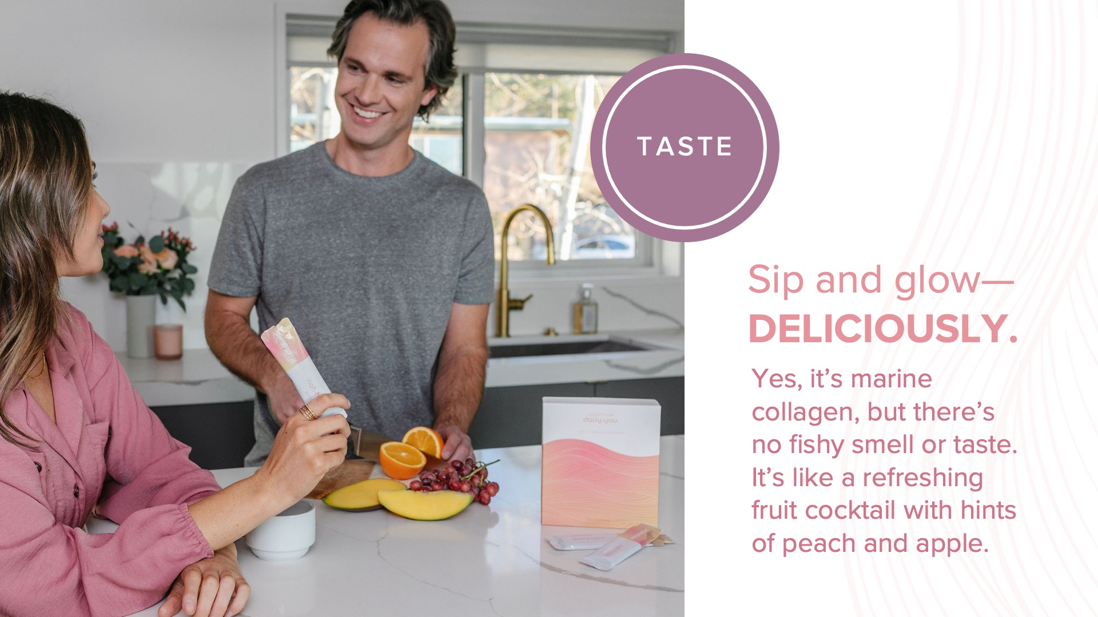
Notes:
Taste
Sip and glow—deliciously.
Yes, it’s marine collagen, but there’s no fishy smell or taste. It’s like a refreshing fruit cocktail with hints of peach and apple. Not too overpowering—just the right amount of fruity fusion.
[CLICK]

Slide 17

Notes:
How to use it
Straight from the sachet. Open and indulge whenever and wherever the mood strikes.

Slide 18
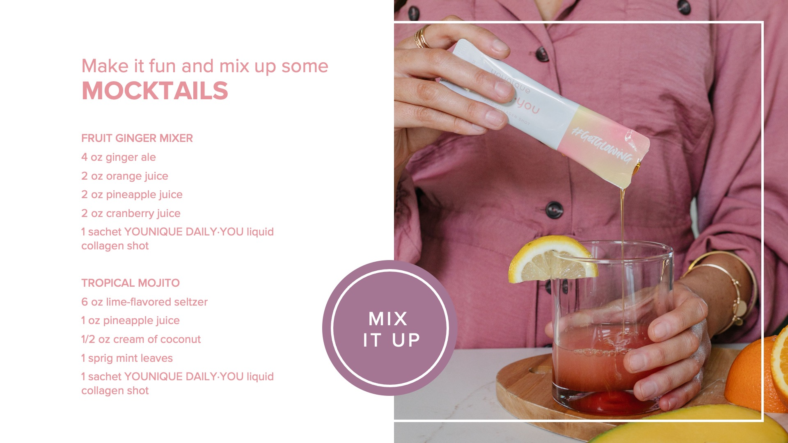
Notes:
withMMOCKTAILSMake it fun and mix up some mocktails!
Here are a couple recipes you’ll want to try out:
Fruit Ginger Mixer
4 oz ginger ale
2 oz orange juice
2 oz pineapple juice
2 oz cranberry juice
1 sachet YOUNIQUE DAILY·YOU liquid collagen shot
Tropical Mojito
6 oz lime-flavored seltzer
1 oz pineapple juice
1/2 oz cream of coconut
1 sprig mint leaves
1 sachet YOUNIQUE DAILY·YOU liquid collagen shot

Slide 19

Notes:
Let’s glow the competition out of the water!
New beauty wellness brand DAILY·YOU
New inner beauty product: YOUNIQUE DAILY·YOU liquid collagen shot
New opportunity to grow your business thanks to a new wellness category, subscription model, and cross-product selling

Slide 20

Notes:
AtrrA brand new Younique opportunity:
Glow your business
Attract new Presenters who are interested in selling wellness products.
Increase subscriptions with a daily consumable that has a specified runout time of 30 sachets.
Customers can take it long term, which means recurring sales.
Increases chances of referrals and reorders.
Keep-Glowing-Strong subscription model drives repeat sales with convenience and added value to customers.
Attract new customers: Collagen production begins to diminish in every individual as they age, so this product allows you to expand your customer base beyond makeup users.
Social media engagement opportunity:
Encourage your team and your customers to light up social channels with #GlowStrong
#GlowStrong is a multifaceted engagement opportunity. It’s all about empowerment from the inside out—from taking charge of your inner wellness to showing the world how uniquely beautiful you are.
#GlowStrong is also about how your radiant spirit brightens other people’s lives as you “glow it forward,” just by being you and by giving back to a cause or charity.
Make sure to focus your posts on the #GlowStrong opportunity by answering some of these questions:
How did you #GlowStrong today?
What’s your #GlowStrong secret?
What or who inspires you to #GlowStrong?

Slide 21

Notes:
And the beauty of it all—your sales keep going & growing
The Keep-Glowing-Strong subscription model drives repeat sales with its convenience and added value to customers.
Presenters and customers who subscribe to a monthly collagen order will save 10% on their YOUNIQUE DAILY·YOU liquid collagen shot, meaning a 30-day supply will cost $89 USD.
To subscribe, navigate to the YOUNIQUE DAILY·YOU liquid collagen shot shop page on youniqueproducts.com and click on Subscribe.
Subscriptions are only available for the 30-count YOUNIQUE DAILY·YOU liquid collagen shot.

Slide 22
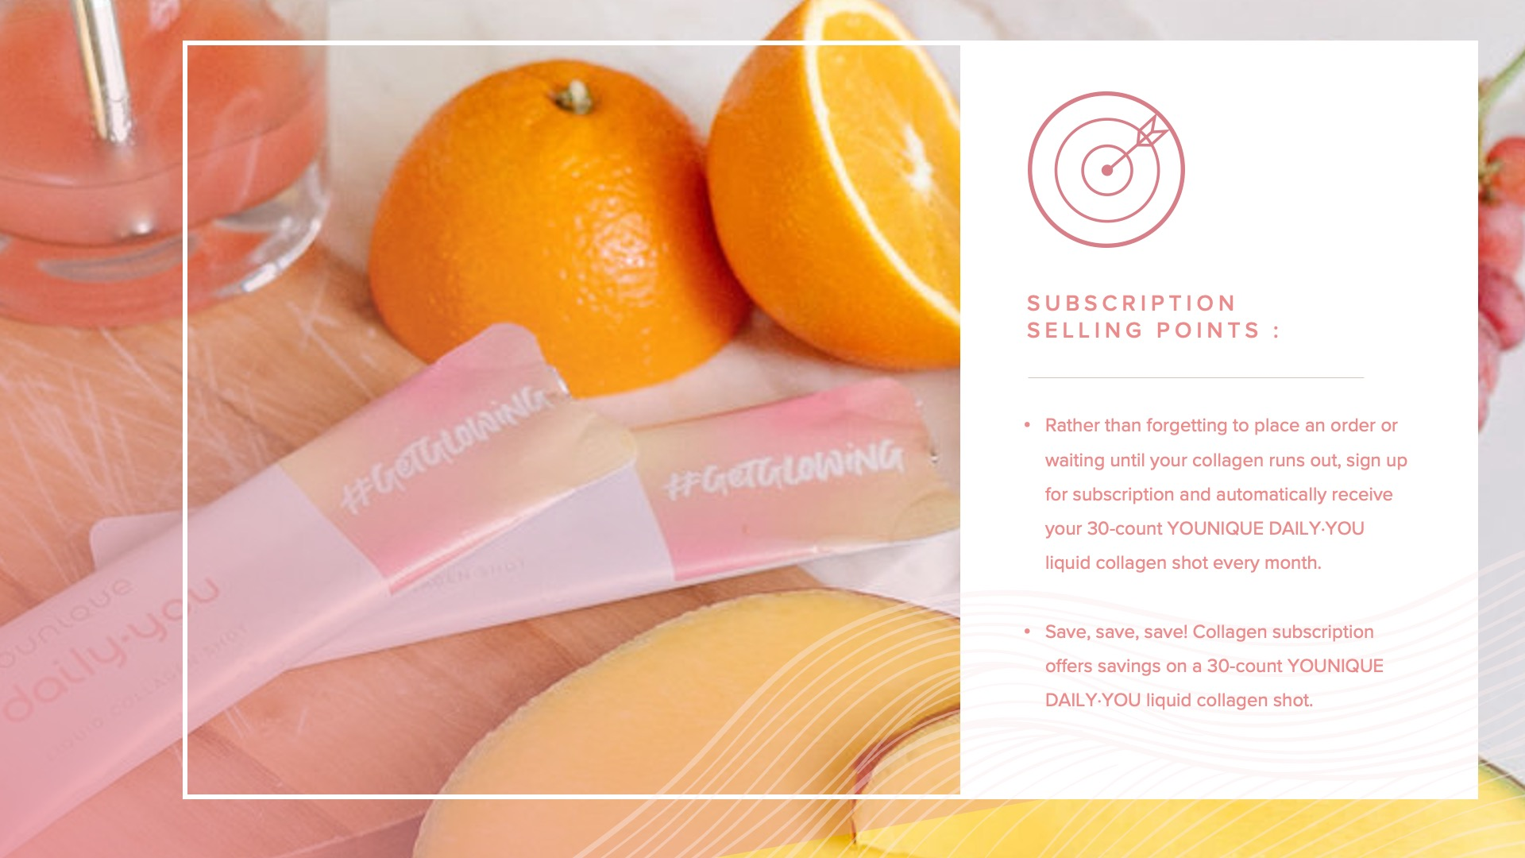
Notes:
Subscription and earning potential
Subscription offers an exciting opportunity to earn more consistent PRS and commissions. As your customers sign up to receive monthly refills through a collagen subscription, you’ll be setting yourself up for a recurring paycheck so you can spend more time focusing on expanding your team, customer base, and other income producing activities.
Subscription selling points for customers:
Rather than forgetting to place an order until your collagen runs out, sign up for subscription and automatically receive your 30-count YOUNIQUE DAILY·YOU liquid collagen shot every month.
Save, save, save! Collagen subscription offers savings of 10% on a 30-count YOUNIQUE DAILY·YOU liquid collagen shot.

Slide 23

Notes:
Pricing:
15-COUNT
$59 USD
30-COUNT
$99 USD
30-COUNT SUBSCRIPTION
$89 USD

Slide 24
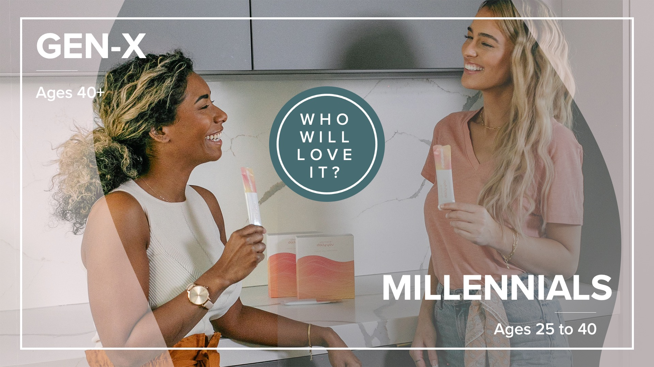
Notes:
Who will love it?
Millennials (Ages 25 to 40)
Millennials want to look and feel good. Lean into the beauty aspects of collagen—position it as a beauty product. Teach them that a solid skin care and wellness routine helps strengthen beauty from the inside out.
Preventative measures are valuable and worth the money, but Millennials need to see the results before they invest. Utilize before and after photos to help show them how collagen has helped others.
Note: Be sure to review Younique's policies on creating and posting before and after photos before you create your own.
Millennials prioritize “me time,” but many have children or other responsibilities and don’t have as much time for themselves as they would like. This quick, pre-packaged shot makes it easy for them to get in their self-care while on the go.
Gen-X (Ages 40+)
Looking good is important, but there are competing priorities with busy family schedules, so they might not get a lot of “me time”—even though they want it. This quick, pre-packaged shot makes it easy for them to prioritize their beauty and wellness from anywhere.
They like makeup and understand that healthy-looking skin is the best foundation. Show them that incorporating collagen can help give them the look they’re going for.
They’re interested in non-invasive solutions for younger-looking skin. Before and after photos are a great way to help show them how collagen has worked for others.
Note: Be sure to review Younique's policies on creating and posting before and after photos before you create your own.

Slide 25
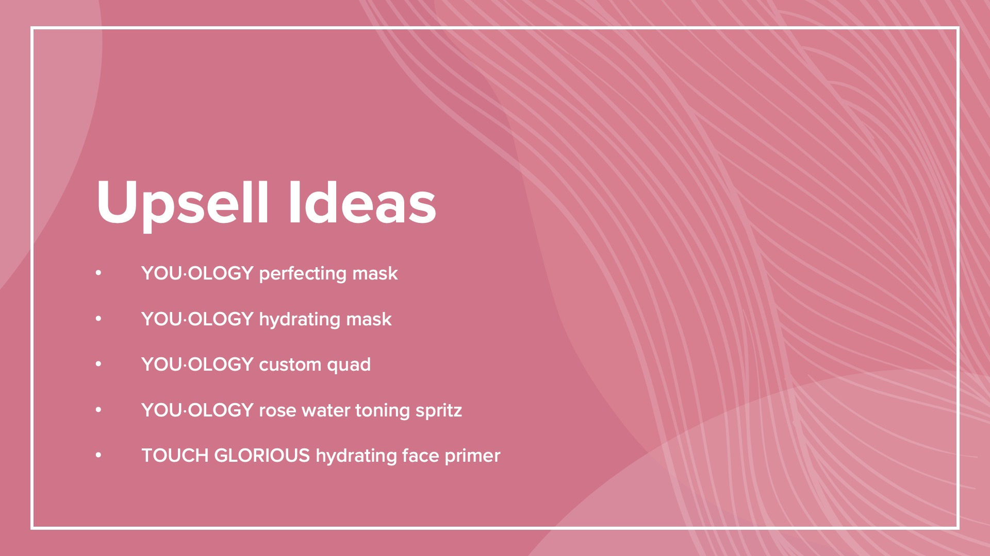
Notes:
Upsell ideas
YOU⋅OLOGY perfecting mask
YOU⋅OLOGY hydrating mask
YOU⋅OLOGY custom quad
YOU⋅OLOGY rose water toning spritz
TOUCH GLORIOUS hydrating face primer

Slide 26

Notes:
Conversation starters
Would you like your skin to appear more hydrated and supple?
Would you like to improve the appearance of your skin’s texture?
Would you like your skin to appear smoother and brighter?
Would you like your skin to appear fuller and bouncier?
Would you like your skin to appear more youthfully radiant?
“Hey, there! Younique just released a brand-new marine collagen, and I think you’d love it!”
“This collagen has shown some incredible results. Not only will it help your skin appear more hydrated and youthful, but it also tastes AMAZING!”
“This is an amazing time to join my team! These 30-count YOUNIQUE DAILY·YOU liquid collagen shot subscriptions help give you an opportunity to have more consistent sales from your Younique business, freeing up more of your time to focus on your goals.”

Slide 27

Notes:
Ways to promote this product:
Create teasers to post or add to your story while waiting for your product to arrive.
Post a before-and-after picture of yourself or share Corporate-created assets.
Note: Be sure to review Younique's policies on creating and posting before and after photos before you create your own.
Post a story or video with you drinking the product and describing the flavor and how it makes you feel.
Take photos of areas of your skin other than your face.
Create a video, story, or post when you start your own collagen journey. Be sure to share your first thoughts.
Create a video, story, or post when you’re well into your collagen journey, making sure to share your experience after 30 days of use.
Post a picture, story, or TikTok of you creating a fun mocktail with YOUNIQUE DAILY·YOU liquid collagen shot.
Let people know why this product is now part of your daily routine by sharing your testimonial and the testimonial of your customers.
Don’t forget to hashtag your posts with #glowstrong #youglowmeaway #jetaime #getglowing #heybeautyBFF #glowonthego #BFFuplift #youniqueproducts #youniquebeauty

Slide 28
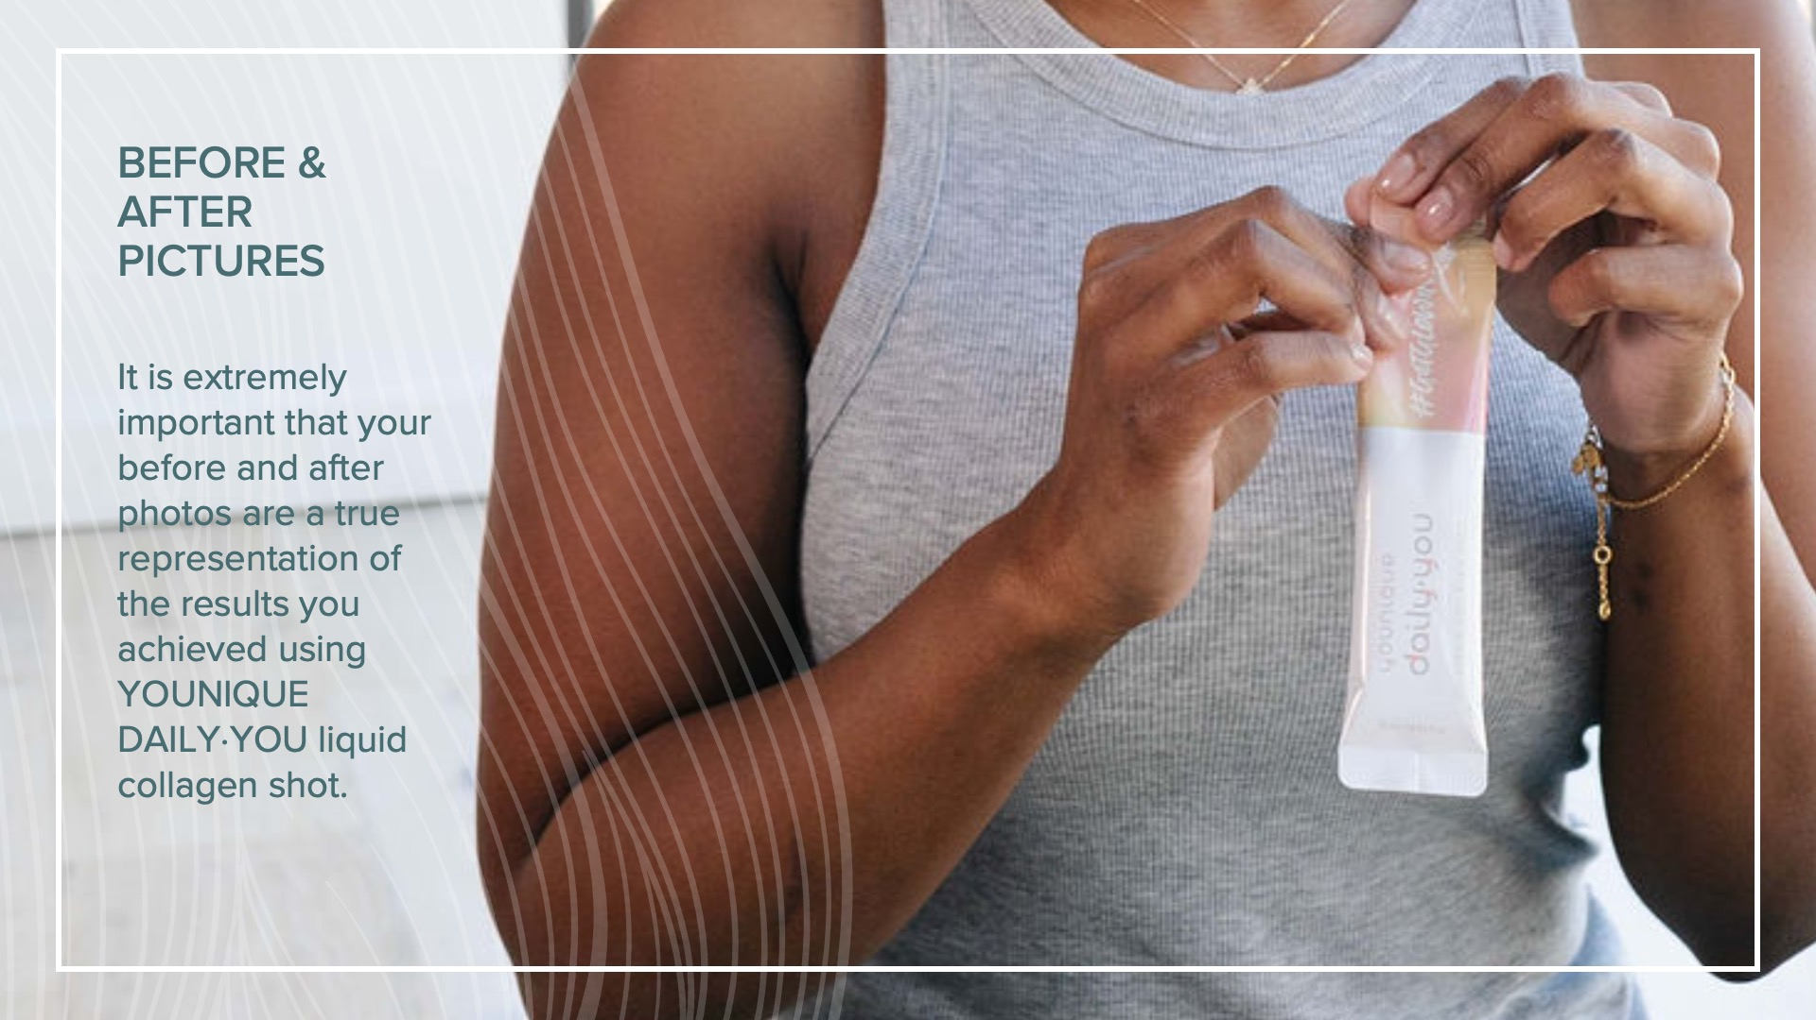
Notes:
Before and after pictures
These photos can help tell your story and show your results after using a product like the
YOUNIQUE DAILY·YOU liquid collagen shot for at least 30 days.
It is extremely important that your before and after photos are a true representation of the results you achieved using YOUNIQUE DAILY·YOU liquid collagen shot. If you choose to share pictures you have taken of your results from daily collagen use, please use the following guidelines to create content that is compliant with the Younique Presenter Agreement.

Slide 29
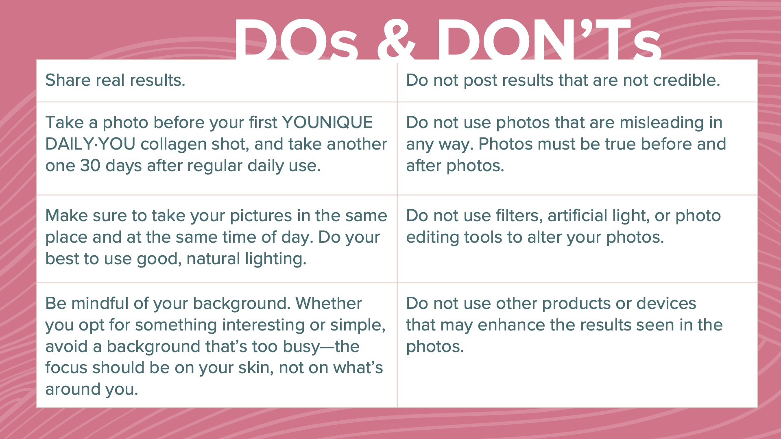
Notes:
YOUNIQUE DAILY·YOU liquid collagen shot before and after pictures dos and don’ts
Do
Don’t
Share real results.
Do not post results that are not credible.
Take a photo before your first YOUNIQUE DAILY·YOU collagen shot, and take another one 30 days after regular daily use.
Do not use photos that are misleading in any way. Photos must be true before and after photos.
Make sure to take your pictures in the same place and at the same time of day. Do your best to use good, natural lighting.
Do not use filters, artificial light, or photo editing tools to alter your photos.
Be mindful of your background. Whether you opt for something interesting or simple, avoid a background that’s too busy—the focus should be on your skin, not on what’s around you.
Do not use other products or devices that may enhance the results seen in the photos.

Slide 30
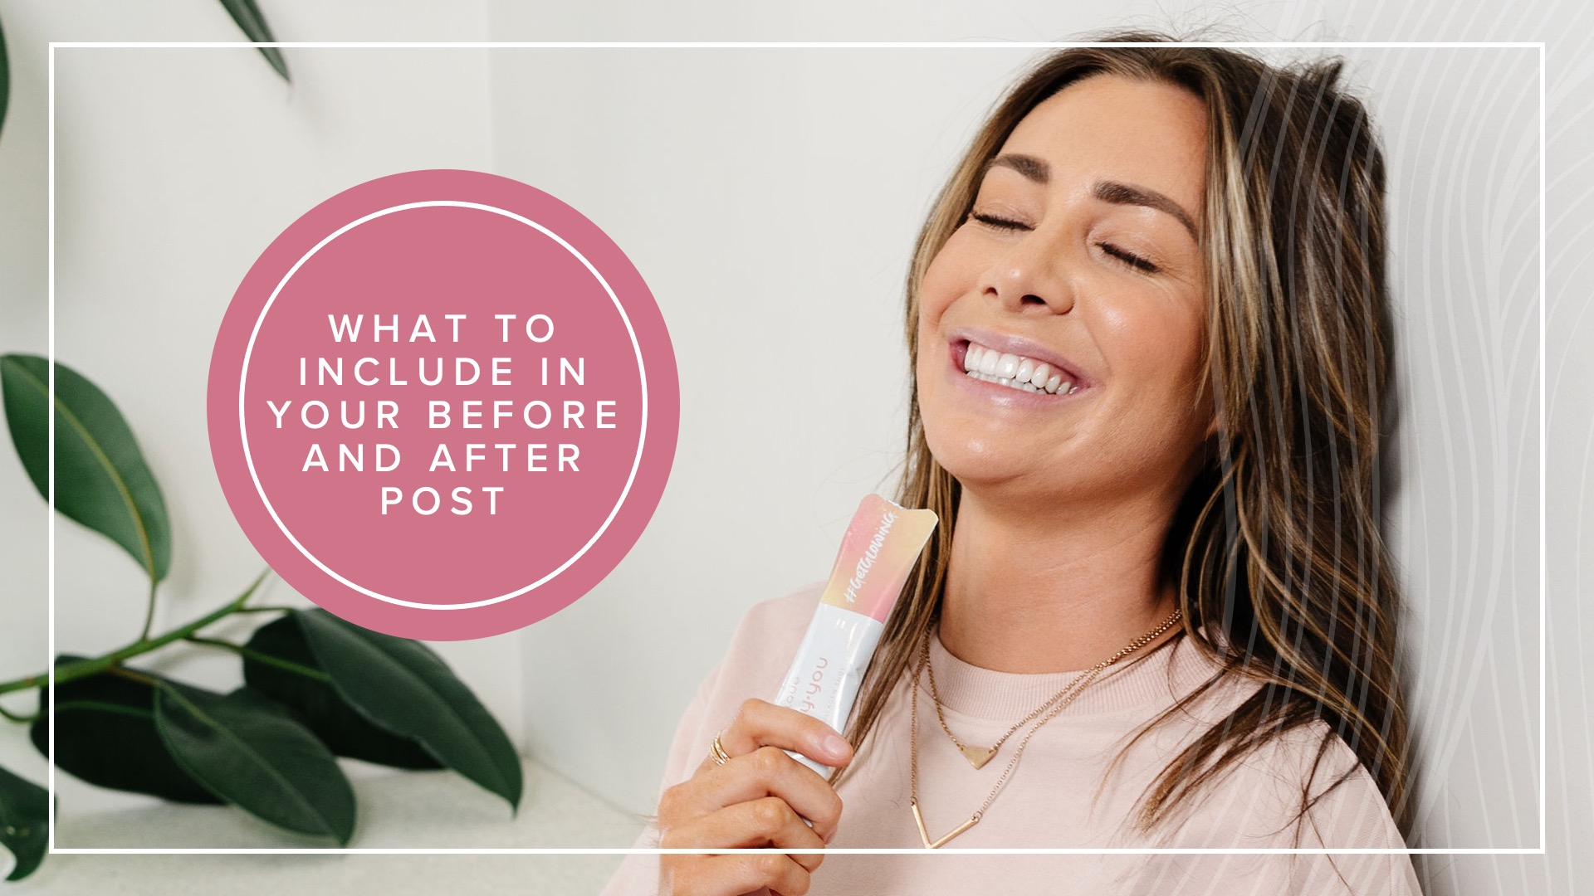
Notes:
What to include in your before and after post:
Language used with your photos may only contain claims provided by Younique.
Include language that clearly indicates that these are your personal results, and the same results may not be achieved by everyone.

Slide 31
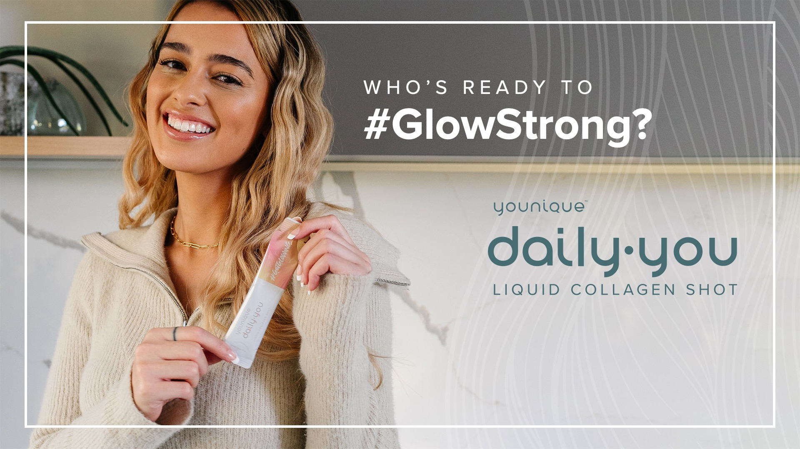
Notes:
So, who’s ready to #GlowStrong?

